Slide 1
International Seminar on Modernizing Official Statistics: Meeting Productivity and New Data Challenges Tianjin, China, October 24 – 26, 2013 Session 5: Modernization of Data Dissemination
Paula Monina G. Collado
Deputy Administrator
National Statistics Office, Philippines

Slide 2
Outline
Background
Motivation
Dissemination Policies
Traditional Dissemination Materials
Modalities of Data Access
New Initiatives on Data Dissemination
Future Directions

Slide 3
Background
National Statistics Office (NSO) is the major statistical agency responsible in collecting, compiling, classifying, producing, publishing, and disseminating general-purpose statistics.
- Commonwealth Act (CA) No. 591
Sources of Data: (1) Censuses, (2) Surveys, and (3) Administrative Forms

Slide 4
Background
Philippine Statistical Act of 2013

Slide 5
Background
Creates a Philippine Statistical Authority
From major statistical agencies engaged in primary data collection and compilation of secondary data
PSA Board and Offices
Philippine Statistical Act of 2013

Slide 6
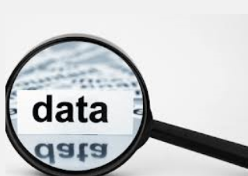
Motivation
Provide input for evidence-based policy making
Provide data for researchers and students for knowledge creation
Informed citizenry thru provision of general-purpose statistics
Wider use of NSO data

Slide 7
Dissemination Policies
Advance Release Calendar
Web Posting and Issuance of Press Releases
Confidentiality of Data
Pricing Policy

Slide 8
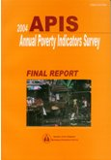
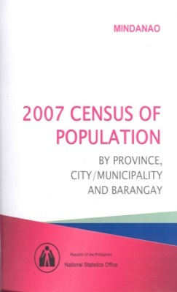
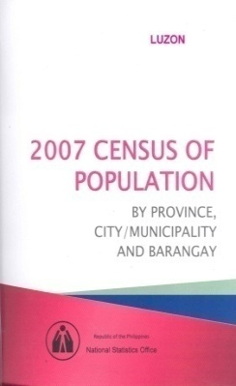
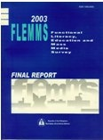
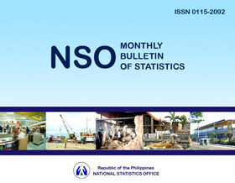
Traditional Dissemination Materials
Publications (Book, CD-ROM)

Slide 9
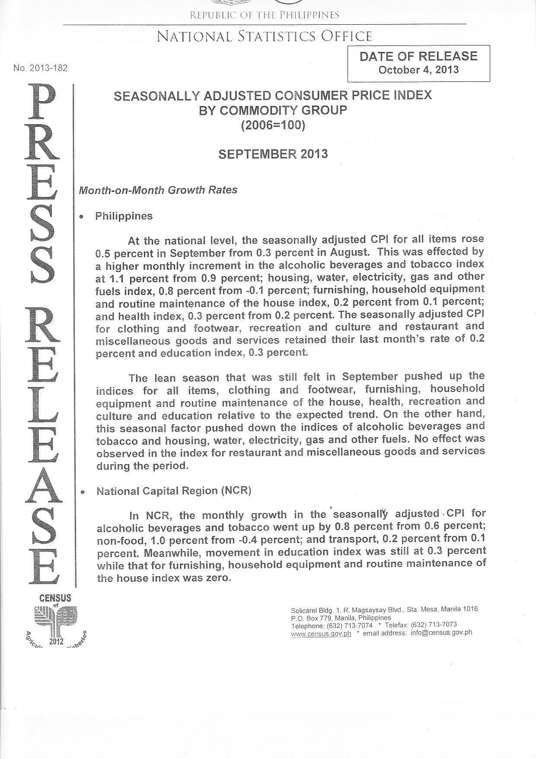
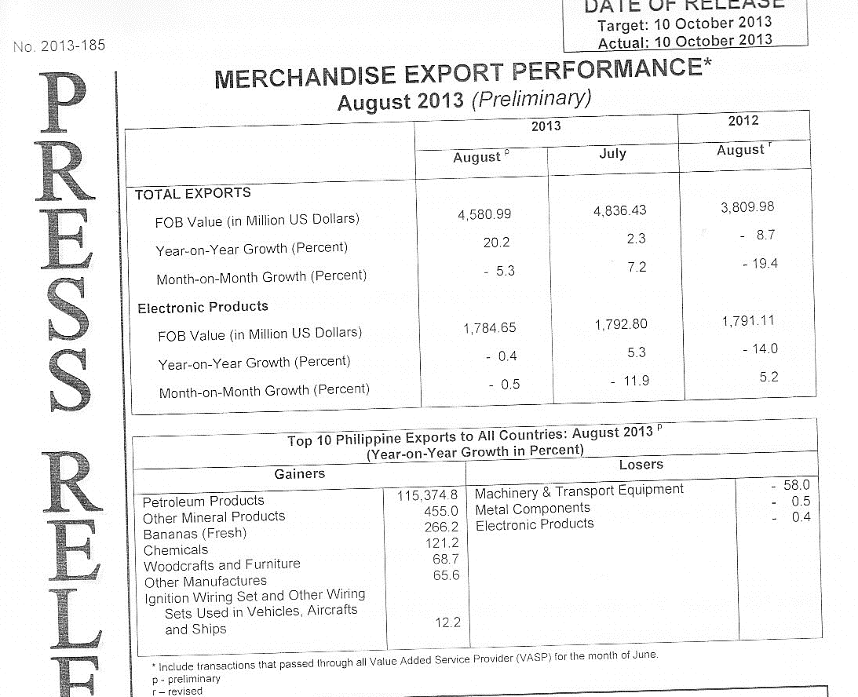
Traditional Dissemination Materials
Press Releases (Tri-media, Web channels)
Special Releases (Tri-media, Web channels)

Slide 10
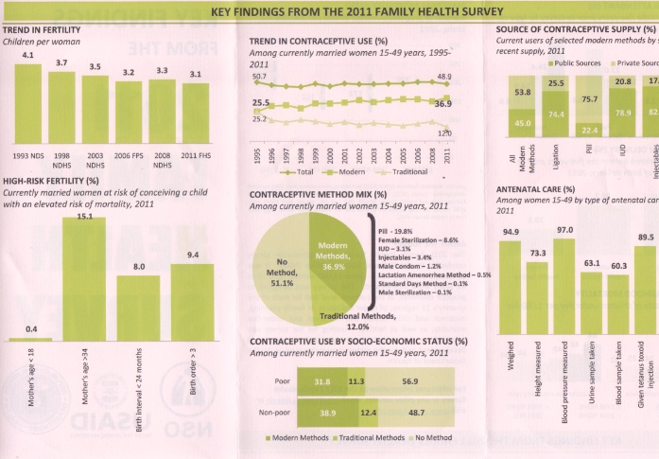
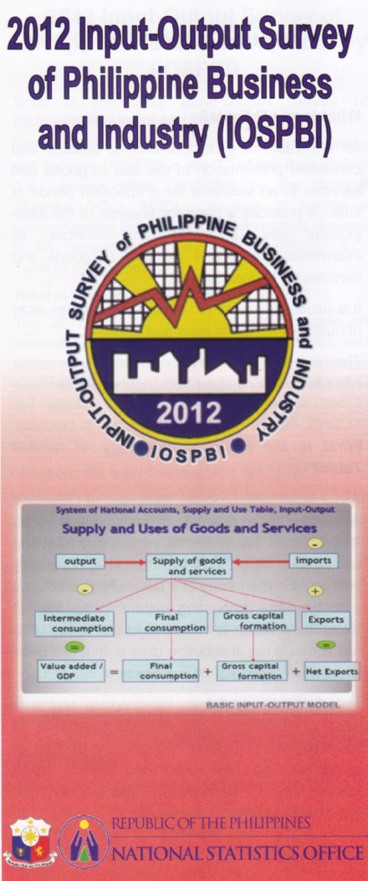
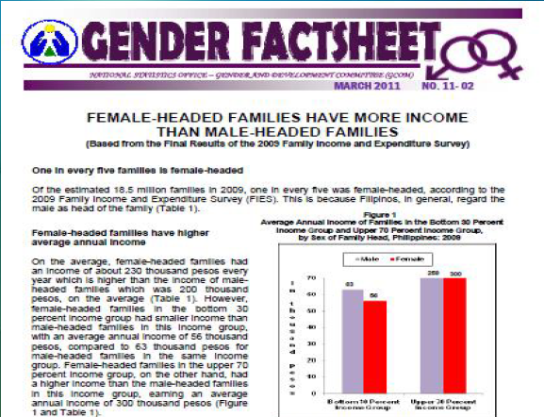
Traditional Dissemination Materials
Bulletins/Factsheets/Primers/Brochures

Slide 11
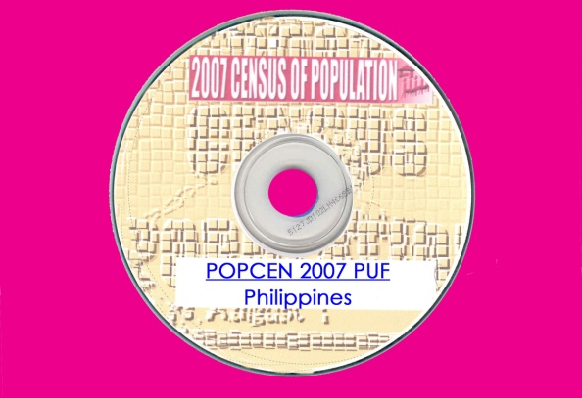
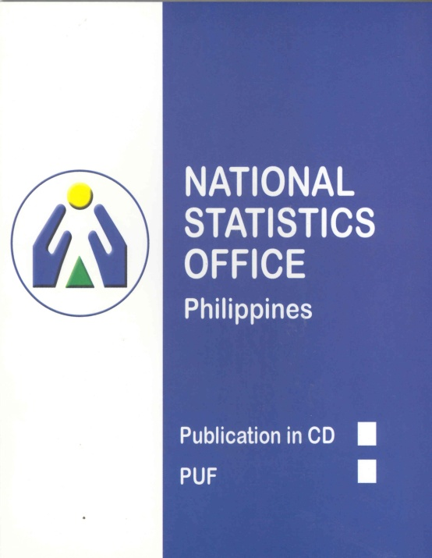
Traditional Dissemination Materials
Licensed Microdata/PUF
Raw data files;
Master files;
Public use files (PUFs);
Licensed microdata files;
Files accessed via remote access; and
Files for use in microdata enclaves

Slide 12
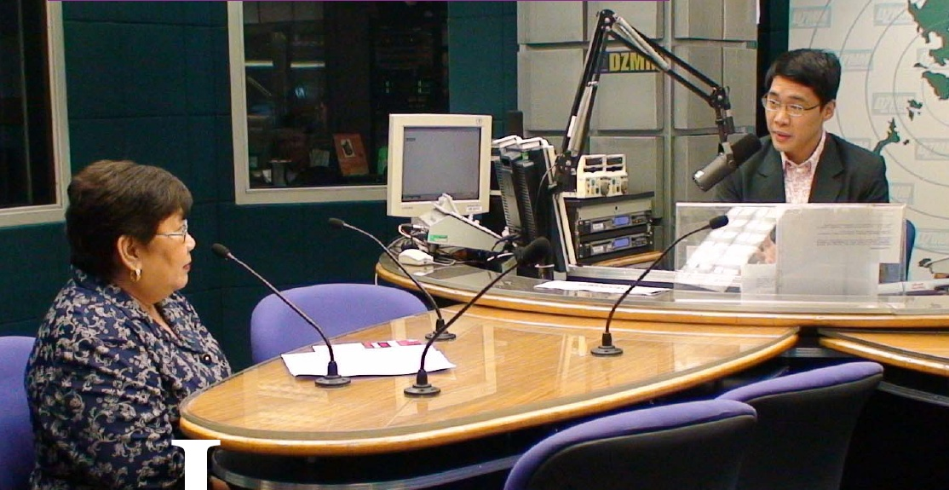
Modalities of Data Access
Television
Radio
- Census Serbilis sa Radyo
Print media/ Newspapers

Slide 13
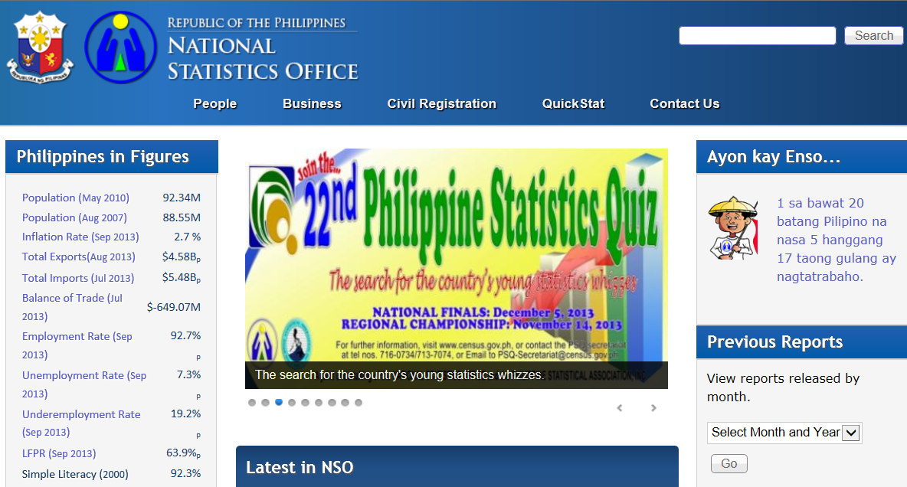
Modalities of Data Access
4. World Wide Web/Internet www.census.gov.ph
5. Emails webmaster@census.gov.ph

Slide 14
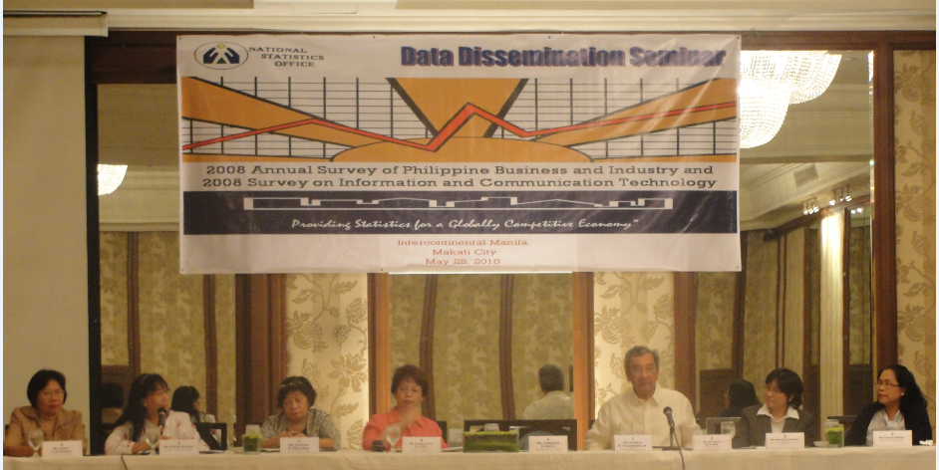
Modalities of Data Access
7. NSO Bulletin Boards
8. NSO Libraries
9. Telephone
10. Postal Mail
11. Fora, Workshops and Seminars
User-producer workshops
Consultative workshops
Advocacy forum
Press conferences

Slide 15
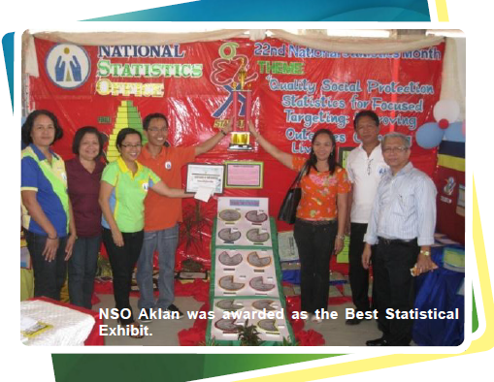
Modalities of Data Access
12. Exhibits
13. Data Enclave

Slide 16
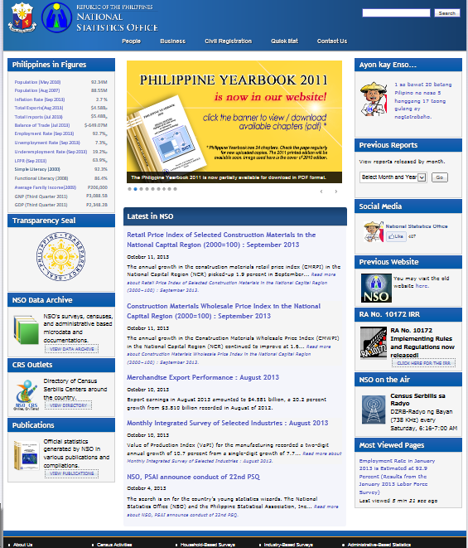
New Initiatives on Data Dissemination
NSO Data Archive (Metadata & Data Catalog)

Slide 17
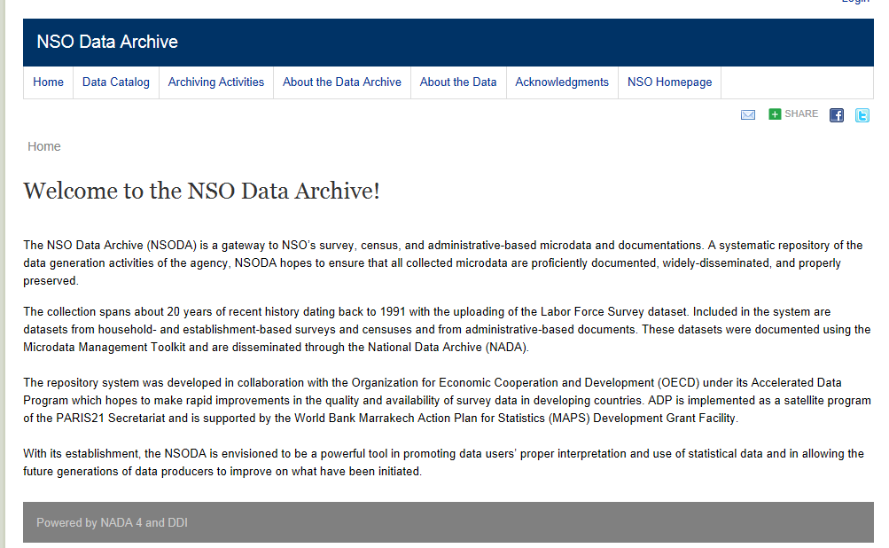
New Initiatives on Data Dissemination
developed in collaboration with the Organization for Economic Cooperation and Development (OECD) under its Accelerated Data Program

Slide 18
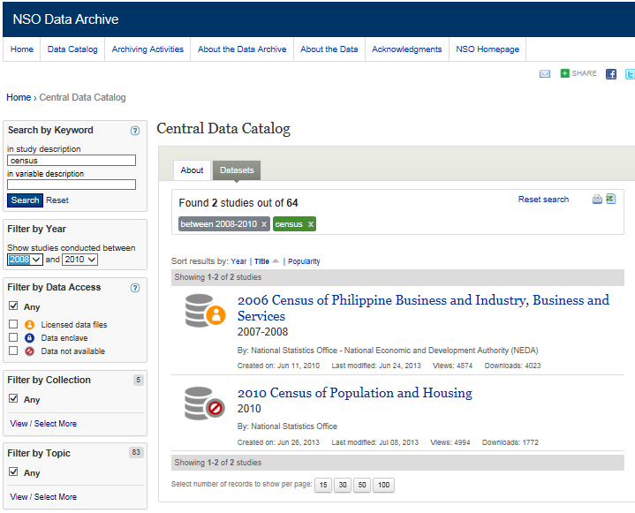
New Initiatives on Data Dissemination

Slide 19
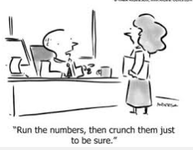
New Initiatives on Data Dissemination
NSO Website to provide data in readable and reusable formats instead of pdf format
Set-up of NSO Data Enclave to allow researchers to use census/survey microdata

Slide 20
New Initiatives on Data Dissemination
Partnership with 88 Accredited Data Centers consisting of libraries of different colleges and universities

Slide 21
Challenges
Conversion of past NSO Website data from pdf to readable and usable format (voluminous)
Include updating of Metadata & Data Catalog as additional task of statistician’s functions
Availability of statisticians to assist researchers using microdata in NSO Data Enclave
Timeliness of NSO publications

Slide 22
Future Directions
Dissemination strategy to align with Open Data Initiative
Enhancement of NSO Data Enclave (availability of more microdata)
Setup Digital Library of NSO publications (pdf)
NSO publications to be made available in the NSO Website

Slide 23
Thank you

Slide 24
International Seminar on Modernizing Official Statistics: Meeting Productivity and New Data Challenges Tianjin, China, October 24 – 26, 2013 Session 5: Modernization of Data Dissemination
Paula Monina G. Collado
Deputy Administrator
National Statistics Office, Philippines

